Slide 1
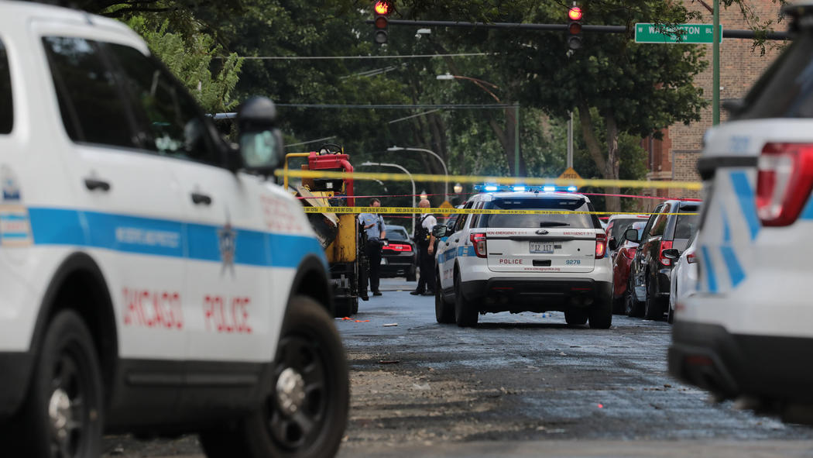
At least 74 people were shot, 12 fatally from Friday, Aug. 3 to Monday, Aug 6, 2018, in Chicago. -- Chicago Tribune

Slide 2

Gun Violence Analysis
Group 1: Cuiting Zhong, Shuyuan Sun, Sichun Zuo

Slide 3
Contents
Project goals
Data Overview
Time Series
Location
Suspect and Victim
Conclusion

Slide 4
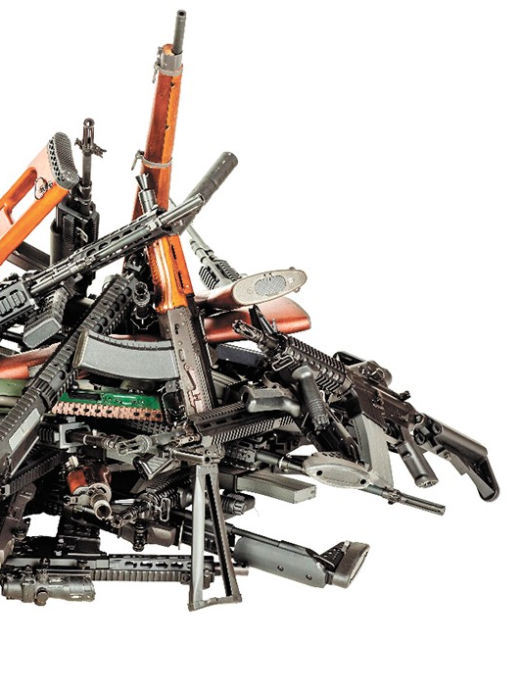
project goals
Description:
Exploratory analysis
Different perspectives
Traits and trends of incidents
Forecast
Importance of the problem:
International students
All of us who live here
Signals for unsafe place, time and people

Slide 5
Data Overview
Name: gun-violence-data_01-2013_03-2018
Observations: 239768
Texas observations: 13577
Variables: 29
Removed: 10
Date: 1
Numerical: 7
Classification: 11

Slide 6
Variables List
Variable Chosen | Variable Chosen | Variable Removed
incident_id, Date, city_or_county, Address, n_killed, n_injured , congressional_district, incident_characteristics, Latitude, location_description, Longitude, | Notes, participant_age, participant_age_group, participant_gender, participant_name, participant_status, participant_type, state_house_district state_senate_district | State, incident_url, source_ur, incident_url, fields_missing, gun_stolen, gun_type, n_guns_involved, participant_relationship, sources

Slide 7
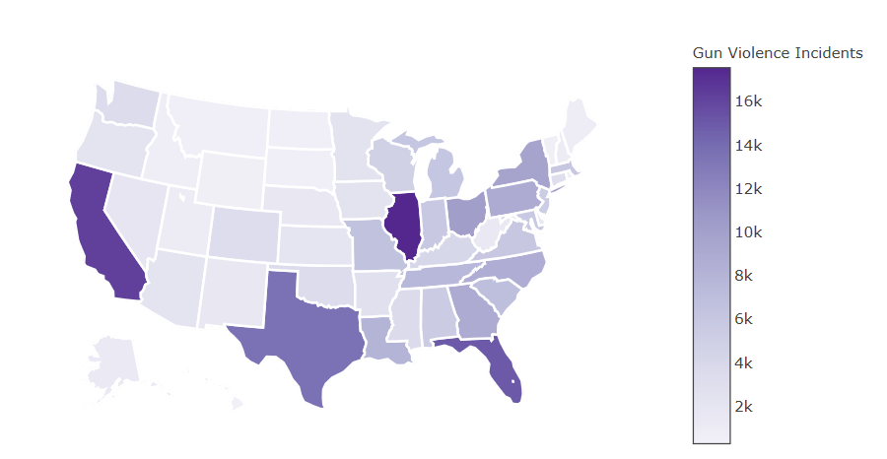
State Wise Number of Gun Violence Incidents

Slide 8

Time Series

Slide 9
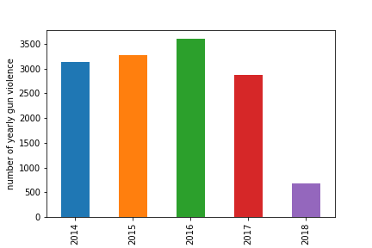
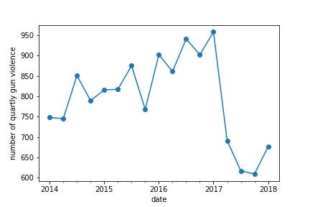
Time Series
Yearly number of gun violence
Quarterly number of gun violence

Slide 10
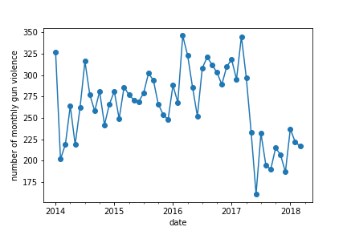
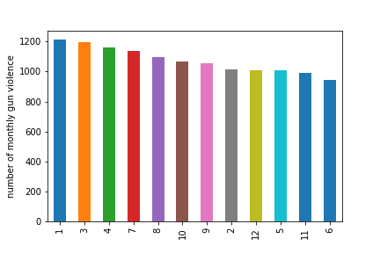
Time Series
Monthly number of gun violence
Monthly number of gun violence

Slide 11
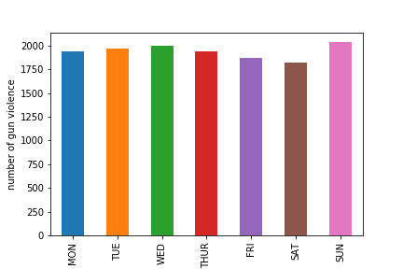
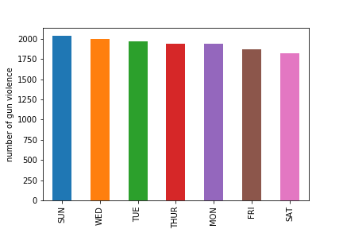
Time Series
Dayofweek number of gun violence
Dayofweek number of gun violence

Slide 12
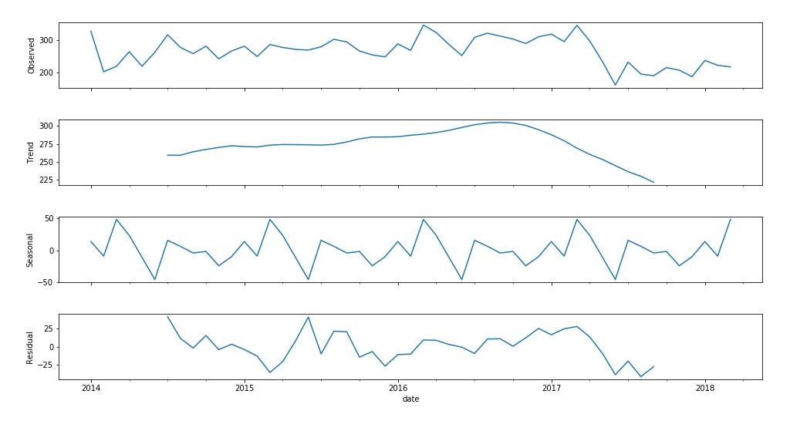
Forecast

Slide 13
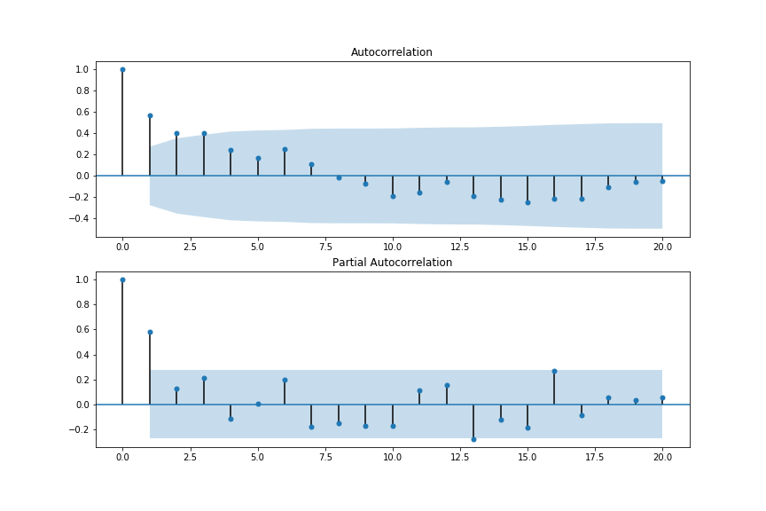
Forecast

Slide 14
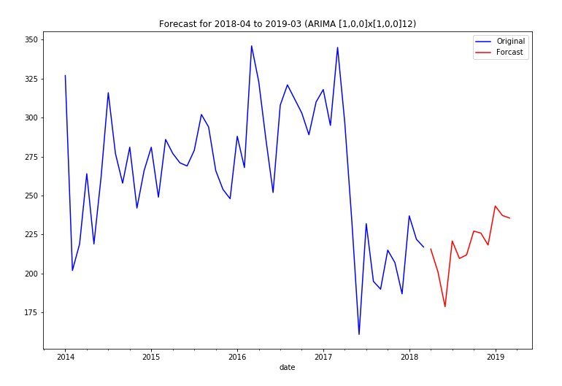
Forecast
ARIMA (1,0,0) x (1,0,0) 12 model:
Yt = 35.6038 + 0.7362 * Yt-1 + 0.4732 * Yt-12
- 0.7362 * 0.4732 * Yt-13 + et
Where et ~ (0, 993.8709)
Date | 2018
 | Apr | May | June | July | Aug | Sep | Oct | Nov | Dec
#of gun violence | 216 | 201 | 179 | 221 | 210 | 212 | 227 | 226 | 218
Date | 2019
 | Jan | Feb | Mar
#of gun violence | 243 | 237 | 236

Slide 15
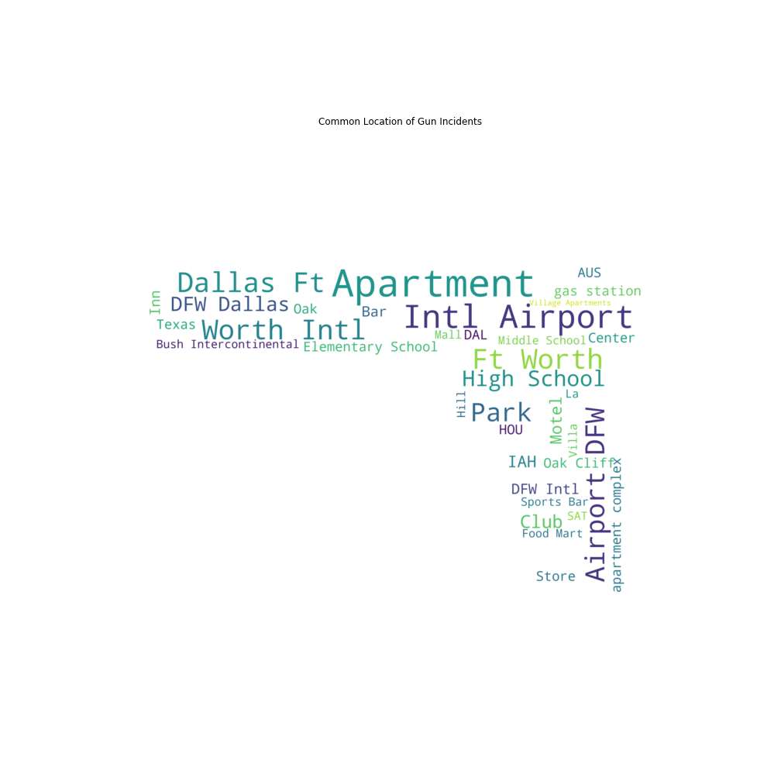
Location Incidents by city
Notes:
in this part we examined how gun violence is related to geographical traits. BTW this picture is a wordcloud we generated from incident descriptions.

Slide 16
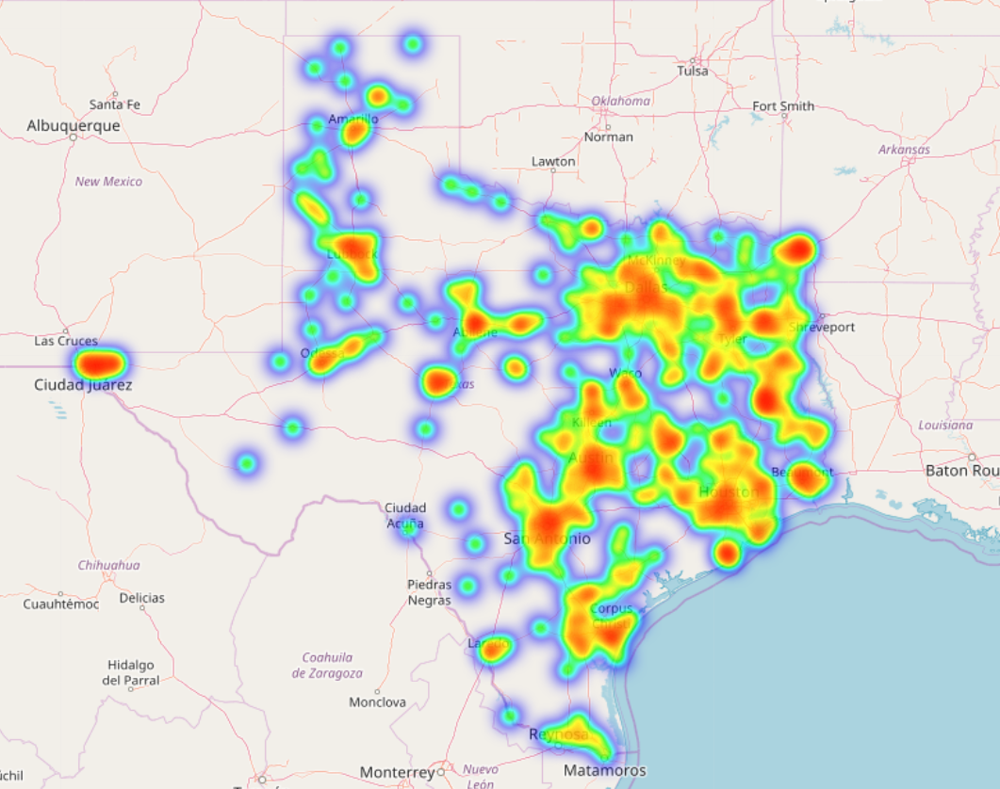
Heatmap-Total no. of incidents
Notes:
According to the heatmap, incidents are more often in the east Texas.

Slide 17
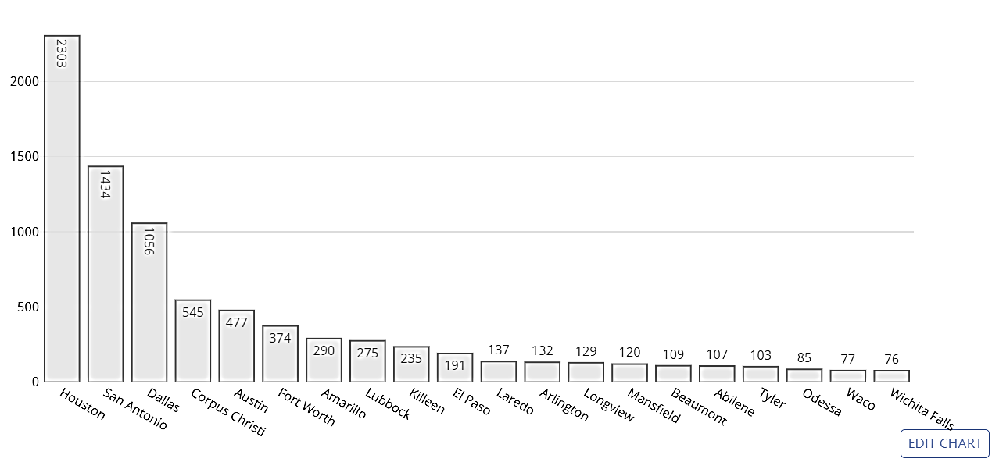
Houston,
San Antonio,
Dallas,
Corpus Christi,
Austin
…..
Total no. of incidents by city-TOP20
Notes:
To be specific, top 5 cities with most incidents are: Houston, San Antonio, Dallas, Corpus Christi, and Austin. This may be because that there are more crimes in these main cities but may also be that these cities are densely populated. So, we then adjusted the number of incidents by population of each city.

Slide 18
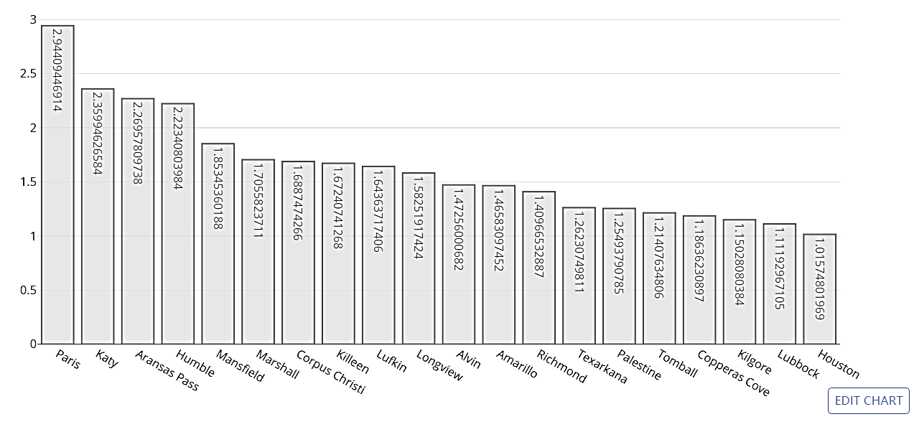
Paris,
Katy,
Aransas Pass,
Humble,
Mansfield
…..
Incidents per 1k people by city-TOP20
Notes:
Top 20 cities with highest number of incidents per 1k residents are a bit different from top 20 with highest total number of incidents. We only consider cities where total number of violence >10 and average population >1000.

Slide 19
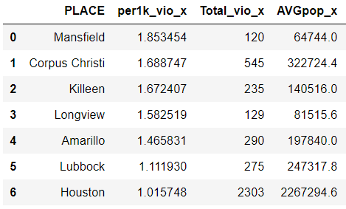
Cities in both TOP20
Notes:
According to the tables, Mansfield, Corpus Christi, Killeen, Longview…etc. appear in both lists. In these cities, one is more likely to encounter gun violence.

Slide 20
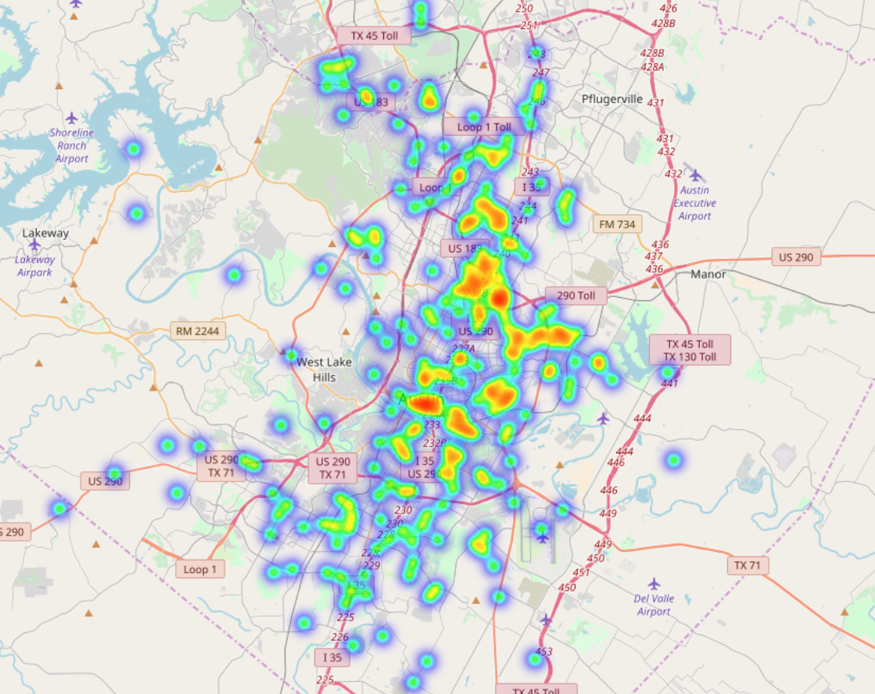
Austin in specific
Notes:
Particularly, In Austin, according to the heatmap, more incidents appear in Downtown, around East Riverside, around Webb Middle School, and so forth.

Slide 21

Location Victims by city
Notes:
Next we explored the relationship of number of victims killed and injured with geographical traits.

Slide 22
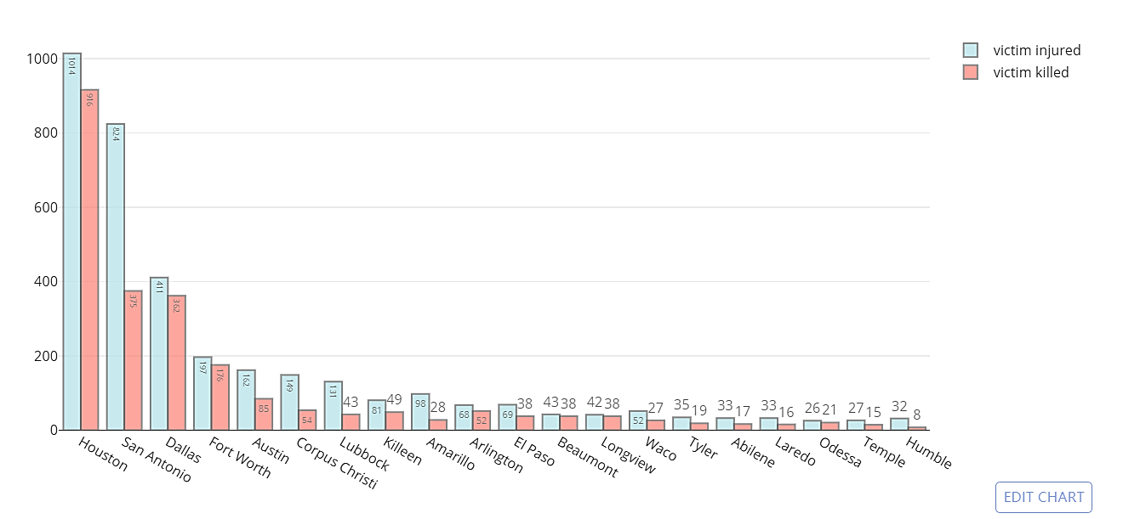
Total no. of victims killed and injured by city (rank by total loss)
Notes:
This is the plot of Total no. of victims killed and injured by city (these cities are ranked in order by total number of victims killed and injured)

Slide 23
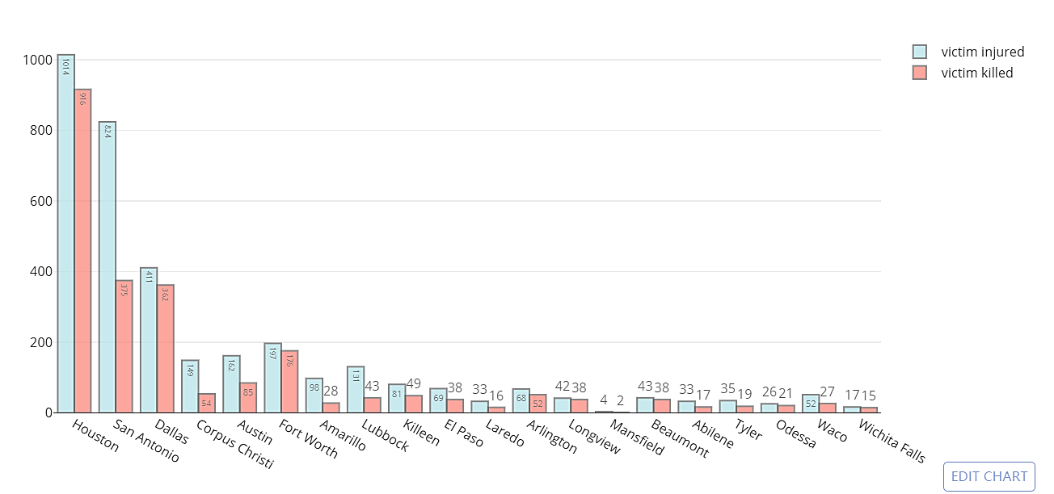
Total no. of victims killed and injured by city (rank by total violence)
Notes:
This is a similar plot but in which (these cities are ranked in order by total number of incidents).
18 cities in the first plot also appear in the second plot.

Slide 24
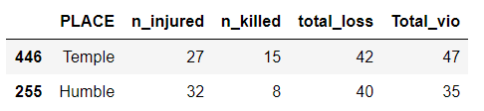
Cities with more people killed or injured while fewer number of incidents
Notes:
Though Temple and Humble are not ranked top by number of incidents, there are more people injured or killed.

Slide 25
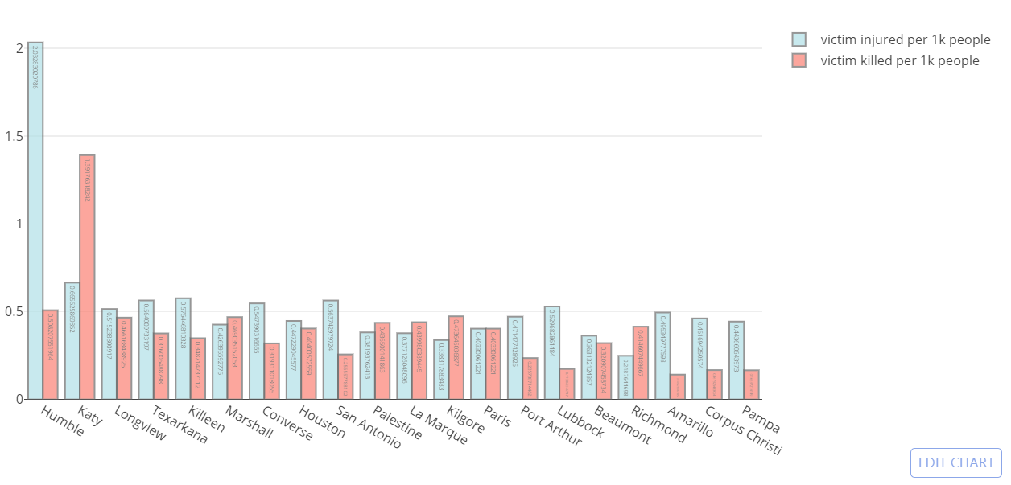
No. of victims killed and injured per 1k people by city
(rank by total loss per 1k people)
Notes:
Then we also examined per 1k data.
This is the plot of no. of victims killed and injured per 1k residents (ranked by number of victims killed and injured per 1k residents)

Slide 26
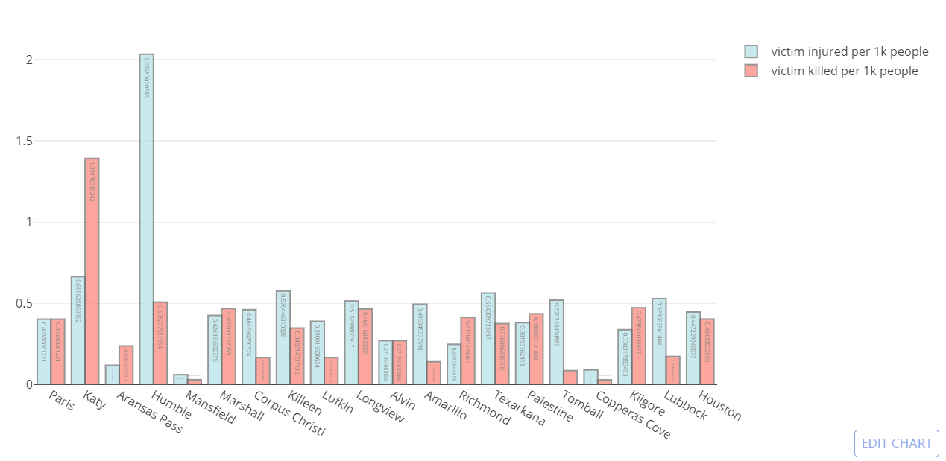
No. of victims killed and injured per 1k people by city
(rank by total violence per 1k people)
Notes:
This is a similar plot but in which (these cities are ranked by total number of incidents per 1k people).
No. of victims killed and injured per 1k people by city
(rank by total violence per 1k people)

Slide 27
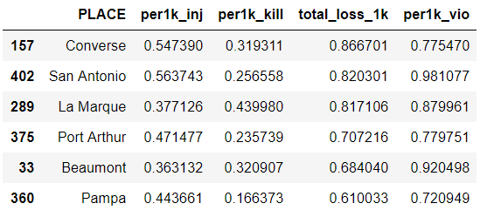
Cities with more people killed or injured per 1k residents while fewer number of incidents per 1k residents
Notes:
Though Converse, San Antonio, La Marque…etc. are not ranked top by number of violence per 1k residents, there are more people injured or killed per 1k residents.

Slide 28

Location Incident characteristic

Slide 29
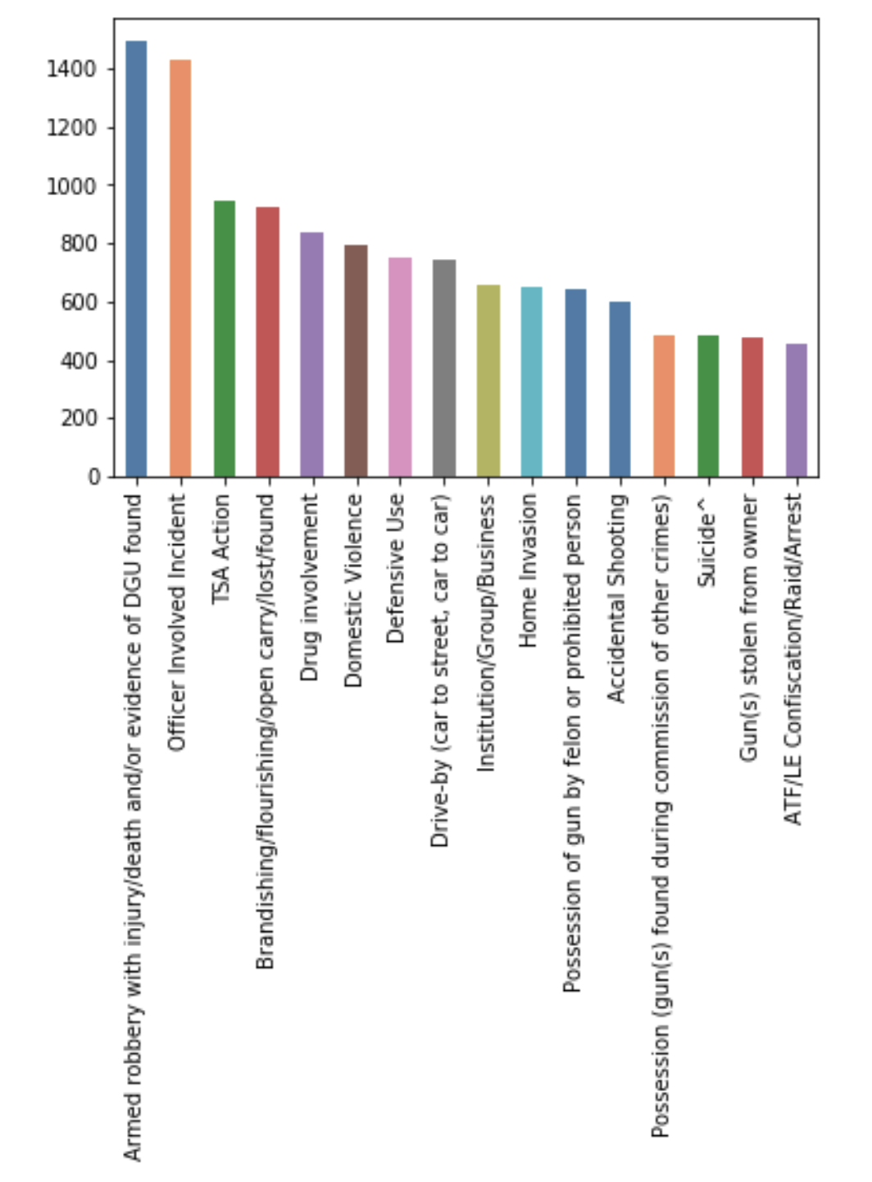
Incident characteristic in Texas total
Notes:
top2 robbery and officer
10% of all incidents
Suspects use gun in robbery most often
officers involved 10% of all the incident

Slide 30
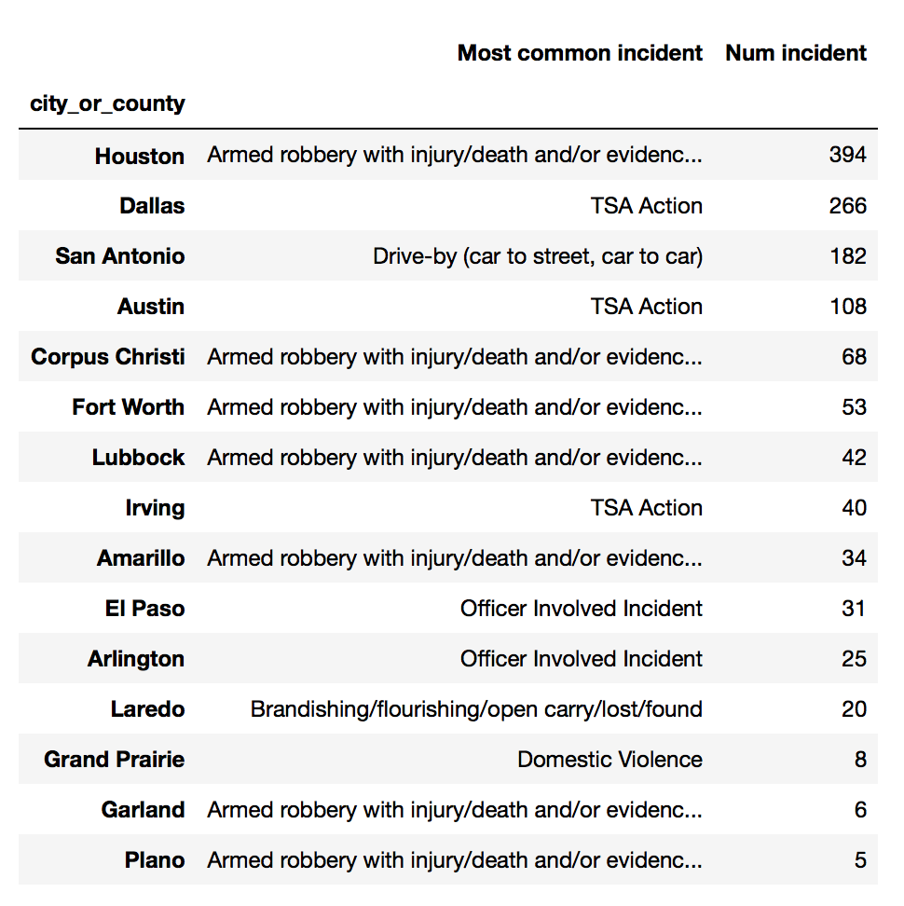
Incident characteristic by city
Notes:
1 top 4
2 Dallas and austin safer

Slide 31
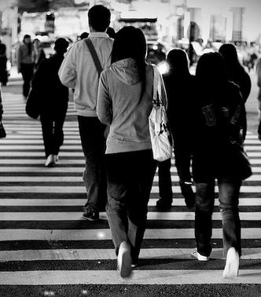
Suspect and Victim

Slide 32
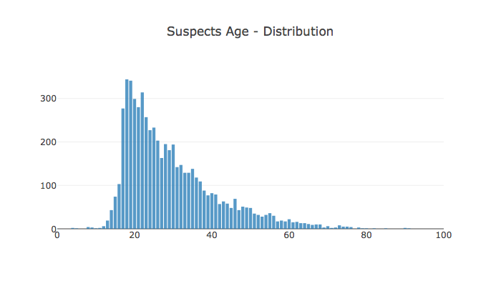
Age Distribution of Suspect
Notes:
1 18/19 340+
2 drop greatly at 30s
3 young people

Slide 33
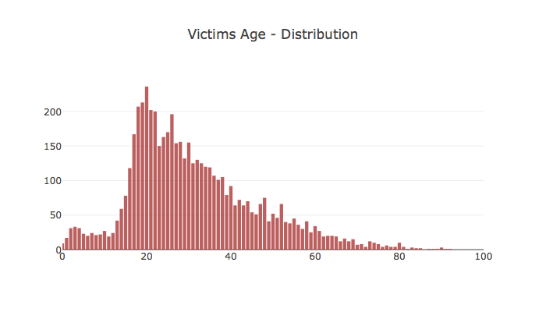
Age Distribution of Victim
Notes:
1 18~22 200+
2 20s~80s decrease mildly
3 child 2~4 30+

Slide 34
Age Distribution of Suspect and Victim
Notes:
1 suspect>victim 100+ 20s
2 same after 40+
3 child been targeted on purpose

Slide 35
Victim Age group percentage
Robbery
drive by
mass-shooting
Notes:
1 select three characteristic
2 divide into three group
3 average teen is about 6% and child is about 3% .
4 low in rob, high in drive-by and mass_shooting

Slide 36
Victim Age group percentage
Robbery
drive by
mass-shooting

Slide 37
Victim Age group percentage
Robbery
drive by
mass-shooting

Slide 38
Suspect Age group percentage
Robbery
drive by
mass-shooting

Slide 39
Suspect Age group percentage
Robbery
drive by
mass-shooting

Slide 40
Suspect Age group percentage
Robbery
drive by
mass-shooting

Slide 41
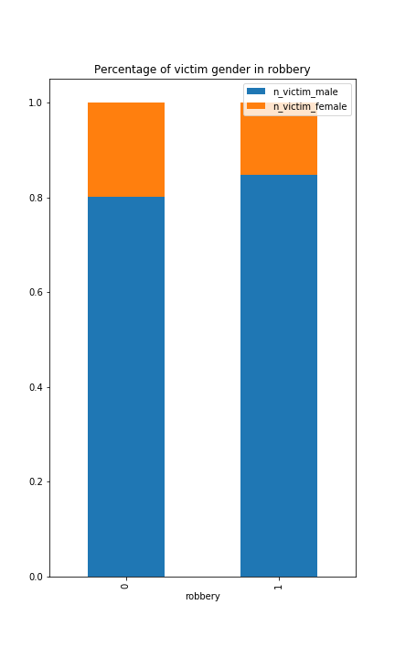
Victim Gender percentage
Robbery
drive by
mass-shooting
Notes:
1 On average, female is 20% in victims.
2 mass_shooting 30%

Slide 42
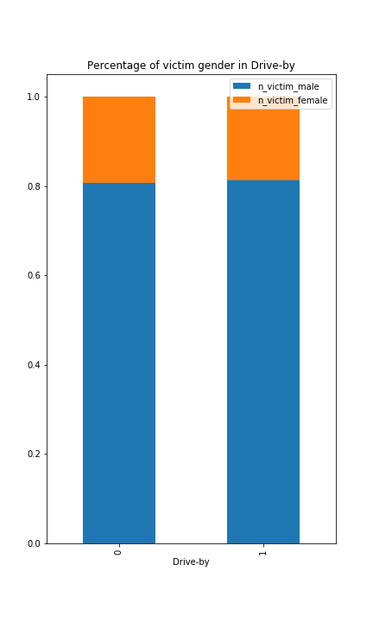
Victim Gender percentage
Robbery
drive by
mass-shooting

Slide 43
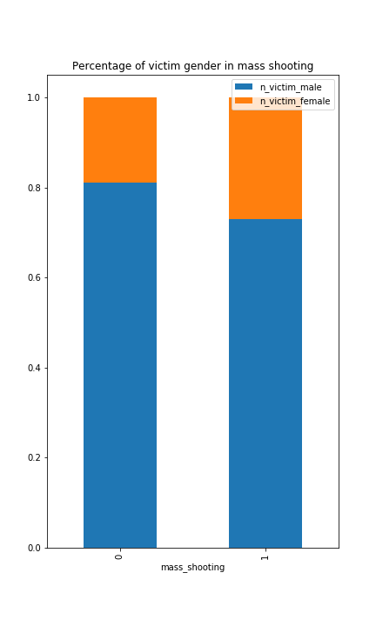
Victim Gender percentage
Robbery
drive by
mass-shooting

Slide 44
Suspect Gender percentage
Robbery
drive by
mass-shooting

Slide 45
Suspect Gender percentage
Robbery
drive by
mass-shooting

Slide 46
Suspect Gender percentage
Robbery
drive by
mass-shooting

Slide 47
Conclusion and insights
Time series and prediction
“Dangerous” places
Traits of incidents and participants
Notes:
1 time; regular fluctuation; up on jan, down on june; main trend goes up in the next few years
2 location: east texas > west; Austin, downtown& east riverside
3 victim: teen and child targeted in drive-by and mass_shooting; female in mass-shooting

Slide 48

Q & A

